Slide 1
Part 3

Slide 2
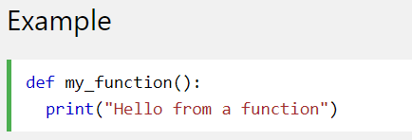

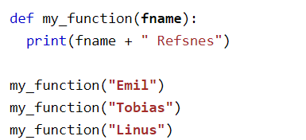
Python Functions
In Python a function is defined using the def keyword:
To call a function, use the function name followed by parenthesis:
Information can be passed into functions as arguments.
Arguments are specified after the function name, inside the parentheses. You can add as many arguments as you want, just separate them with a comma.
The following example has a function with one argument (fname). When the function is called, we pass along a first name, which is used inside the function to print the full name:

Slide 3
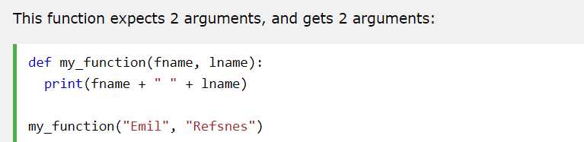
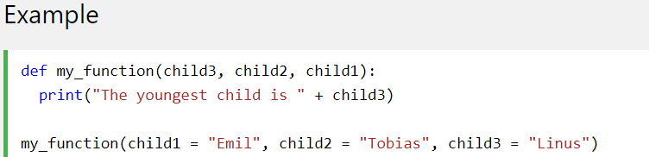
Python Functions
By default, a function must be called with the correct number of arguments. Meaning that if your function expects 2 arguments, you have to call the function with 2 arguments, not more, and not less.
Keyword Arguments
You can also send arguments with the key = value syntax.
This way the order of the arguments does not matter.

Slide 4
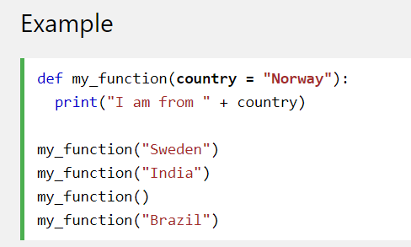
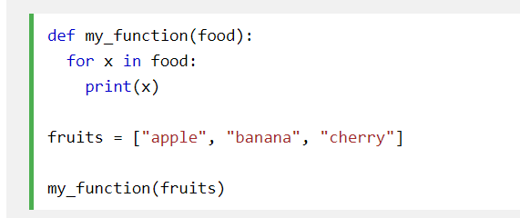
Python Functions
Default Parameter Value
The following example shows how to use a default parameter value.
If we call the function without argument, it uses the default value:
You can send any data types of argument to a function (string, number, list, dictionary etc.), and it will be treated as the same data type inside the function.
E.g. if you send a List as an argument, it will still be a List when it reaches the function:

Slide 5
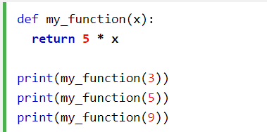
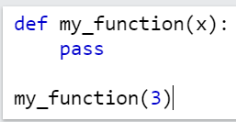
Python Functions
Return Values
To let a function return a value, use the return statement:
The pass Statement
function definitions cannot be empty, but if you for some reason have a function definition with no content, put in the pass statement to avoid getting an error.

Slide 6
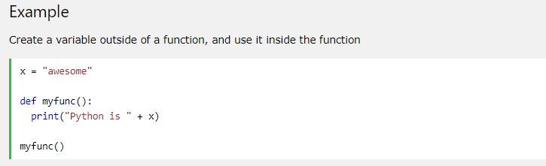

Python - Global Variables
Global Variables
Variables that are created outside of a function (as in all of the examples above) are known as global variables.
Global variables can be used by everyone, both inside of functions and outside.

Slide 7
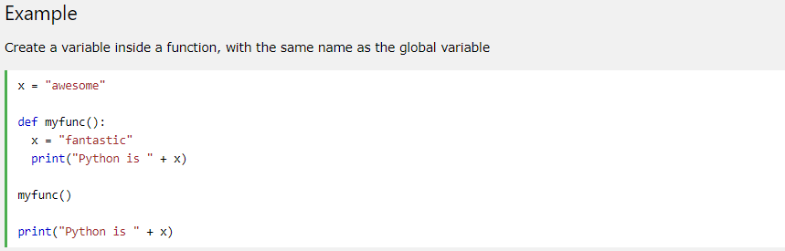
Python - Global Variables
If you create a variable with the same name inside a function, this variable will be local, and can only be used inside the function. The global variable with the same name will remain as it was, global and with the original value.

Slide 8
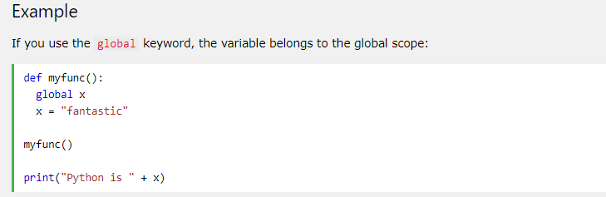

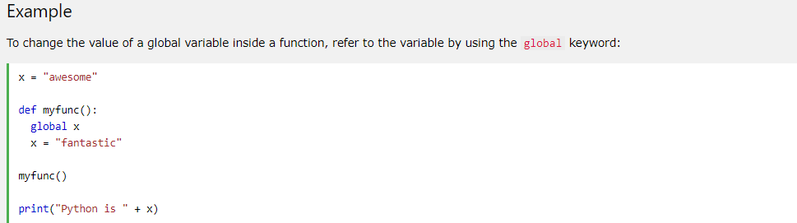

Python - Global Variables
The global Keyword
Normally, when you create a variable inside a function, that variable is local, and can only be used inside that function.
To create a global variable inside a function, you can use the global keyword.
Also, use the global keyword if you want to change a global variable inside a function.

Slide 9
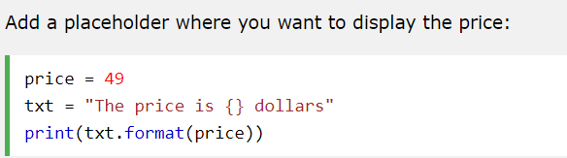

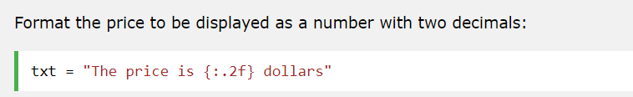

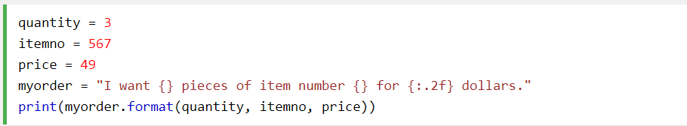

Python String Formatting
To make sure a string will display as expected, we can format the result with the format() method.
The format() method allows you to format selected parts of a string.
Sometimes there are parts of a text that you do not control, maybe they come from a database, or user input?
To control such values, add placeholders (curly brackets {}) in the text, and run the values through the format() method:
You can add parameters inside the curly brackets to specify how to convert the value:
If you want to use more values, just add more values to the format() method:

Slide 10
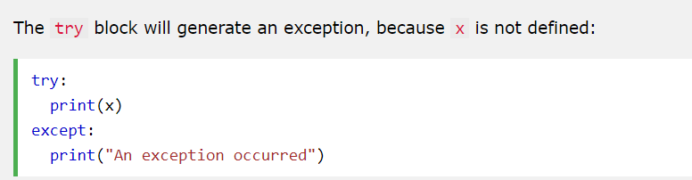

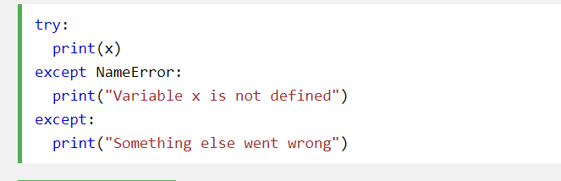
Python Try Except
The try block lets you test a block of code for errors.
The except block lets you handle the error.
The finally block lets you execute code, regardless of the result of the try- and except blocks.
You can define as many exception blocks as you want, e.g. if you want to execute a special block of code for a special kind of error:

Slide 11
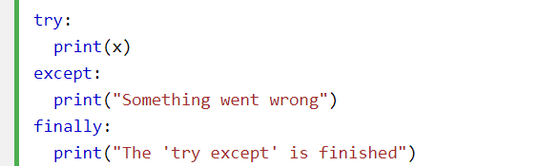
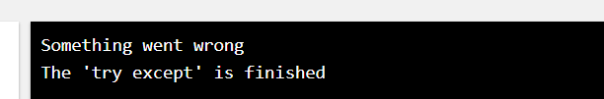
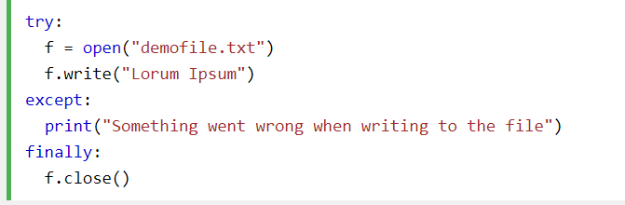
Python Try Except
The finally block, if specified, will be executed regardless if the try block raises an error or not.
This can be useful to close objects and clean up resources:

Slide 12
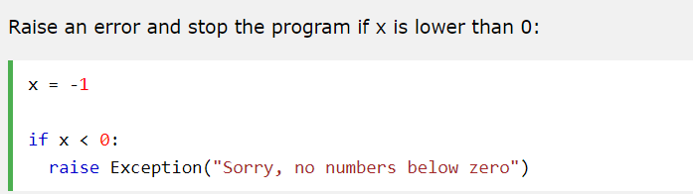
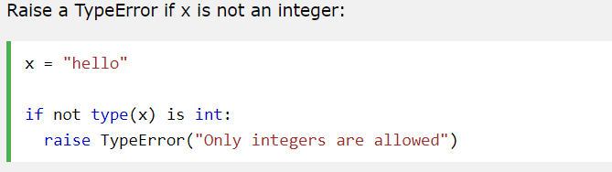
Raise an exception
As a Python developer you can choose to throw an exception if a condition occurs.
To throw (or raise) an exception, use the raise keyword
The raise keyword is used to raise an exception.
You can define what kind of error to raise, and the text to print to the user.

Slide 13


Python User Input
Python 3.6 uses the input() method.
You can cast the input type
מקורות
https://www2.slideshare.net/LiliaSfaxi/software-engineering-chp4-design-patterns
https://www.journaldev.com/1377/java-singleton-design-pattern-best-practices-examples

